Slide 1
Lecture 1+ – Function Calls
Programming
Principles and Practice Using C++
Shengfa Wang
sfwang@dlut.edu.cn

Slide 2
Parameter Passing
There are two ways (in C++) to pass parameters to functions.
  Pass by Value (what we’ve seen so far)
  Pass by Reference
In the functions we have seen so far, the input parameters are passed by value. In other words, the values of the parameters are copied.

Slide 3
Arguments and Parameters
Parameter is the receiving variable used w/in the function/block
Argument is the value/variable/reference being passed in
void Foo(int i, float f)
{
// Do things
}
void Bar()
{
int anInt = 1;
Foo(anInt, 2.0);
}. . .
i and f are the parameters
anInt and 2.0 are the arguments
Notes:
形参 实参

Slide 4
How Function Calls Work
A function call uses the “program call stack”
  Stack frame is “pushed” when the call is made
  Execution jumps to the function’s code block
  Function’s code block is executed
  Execution returns to just after where call was made
  Stack frame is “popped” (variables in it destroyed)

Slide 5
Normally Pass by Value is Used
Normally when we call a function, the values we pass as parameters are first copied. The copies are sent to the function as parameters.
Local variables and parameters actually reside in an area of memory called the stack. When parameters are passed, new copies of their values are created and stored on the stack.
The downside is that the function cannot alter the original value. The value the function alters is only its local copy of the original.

Slide 6
Example
Void Add25 (int a)
{
a = a + 25;
}
int main()
{
int a = 10;
Add25(a);
cout<<a;
return 0;
}

Slide 7
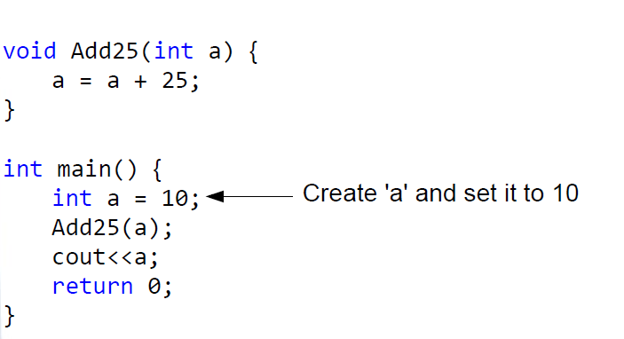
Example

Slide 8
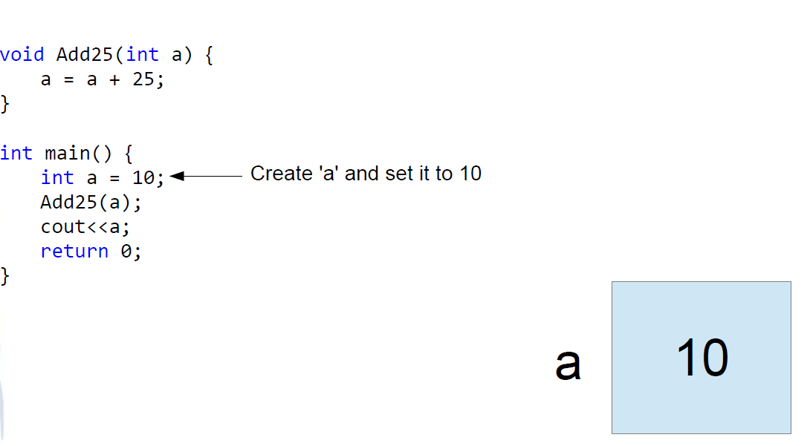
Example

Slide 9
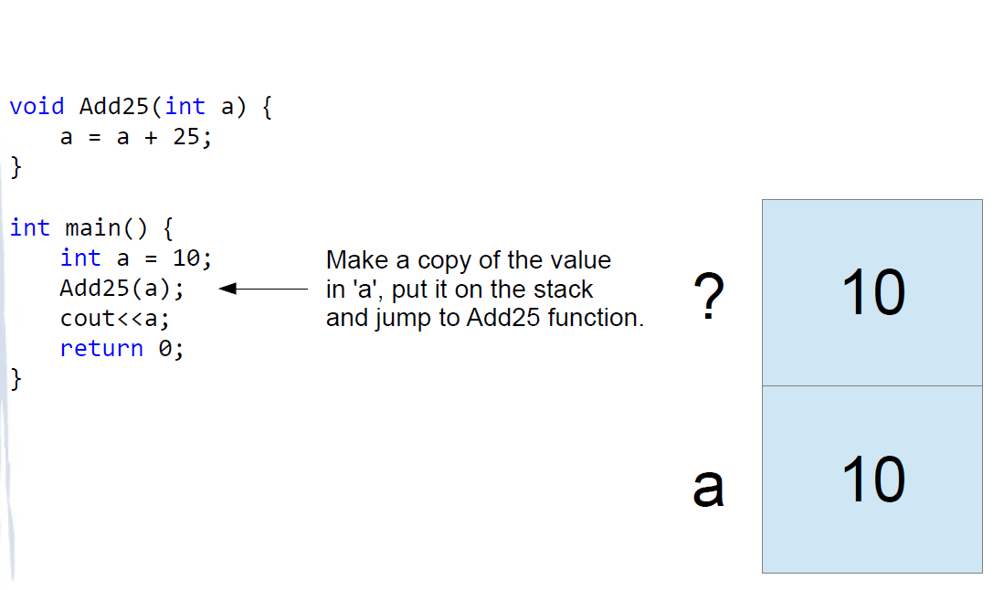
Example

Slide 10
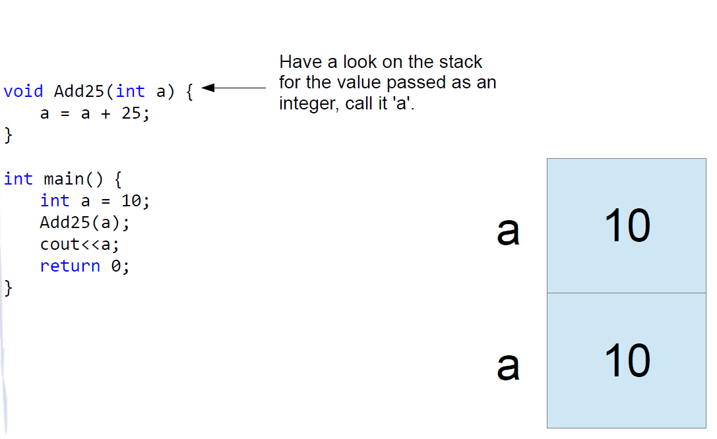
Example

Slide 11
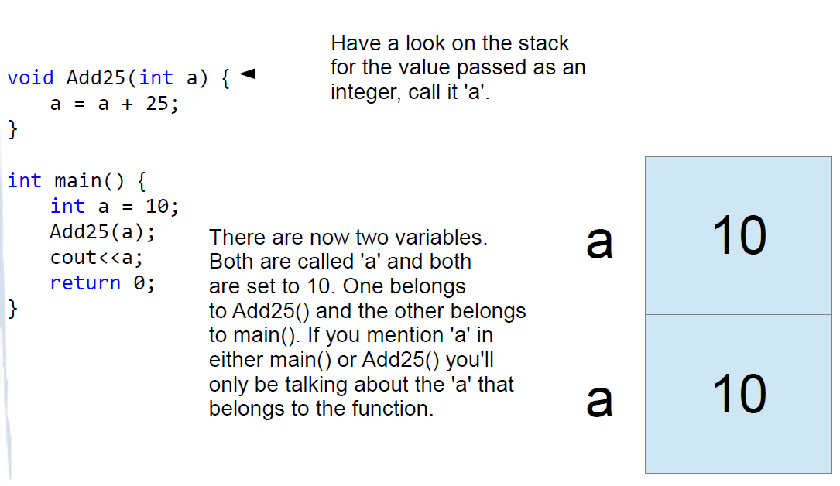
Example

Slide 12
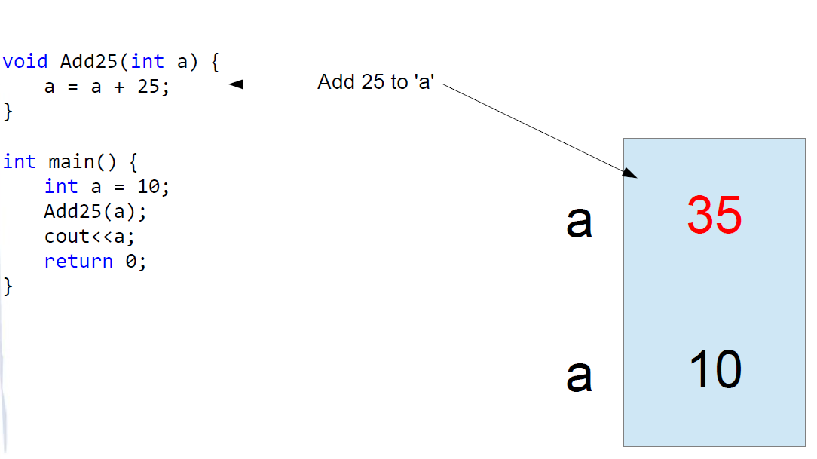
Example

Slide 13
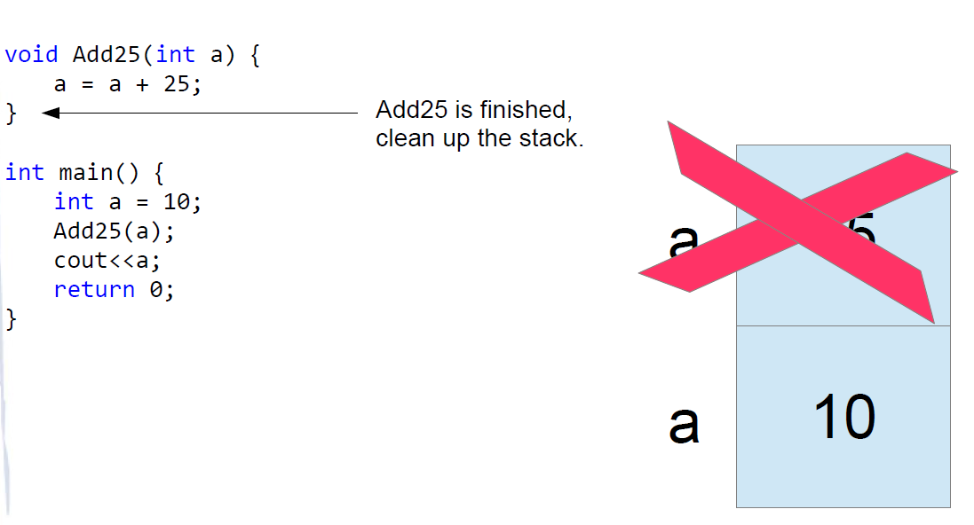
Example

Slide 14
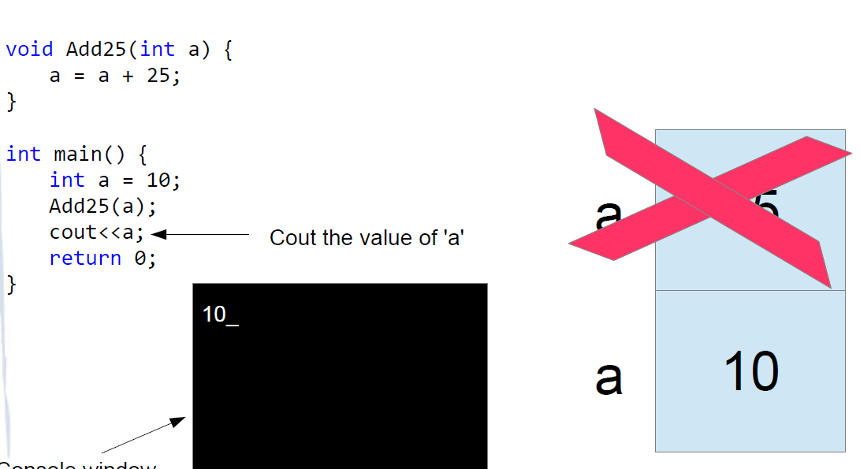
Example

Slide 15
The 'a' belonging to Main was not altered by the function
In the previous example the Add25() function added 25 to it's own copy of 'a', this has no effect on the copy of 'a' that belongs to main().
The Add25() function needn't have called its copy 'a'. It could have called it whatever it wanted, but the point is that the two variables are completely different even if they have the exact same name!

Slide 16
What if you want Add25 to change the main() 'a'?
We've already looked at pointers and these will enable us to change the copy of 'a' that belongs to main() from within the Add25 function.
Let's look at how we might do this then we'll look at a special syntax that makes the process even easier.

Slide 17
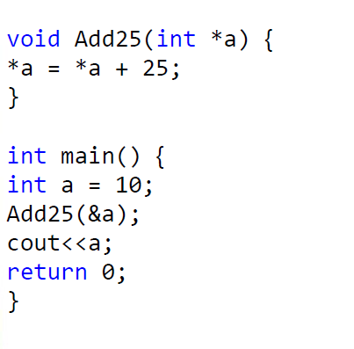
Using Pointers to Allow Add25 to Change main's 'a' variable

Slide 18
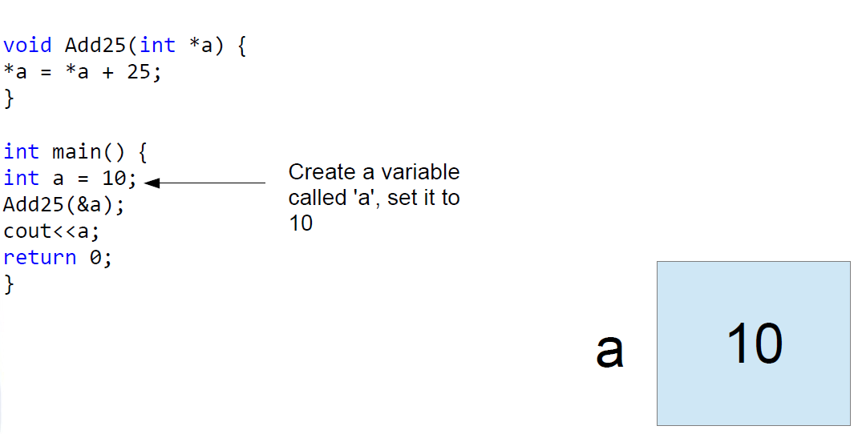
Using Pointers to Allow Add25 to Change main's 'a' variable

Slide 19
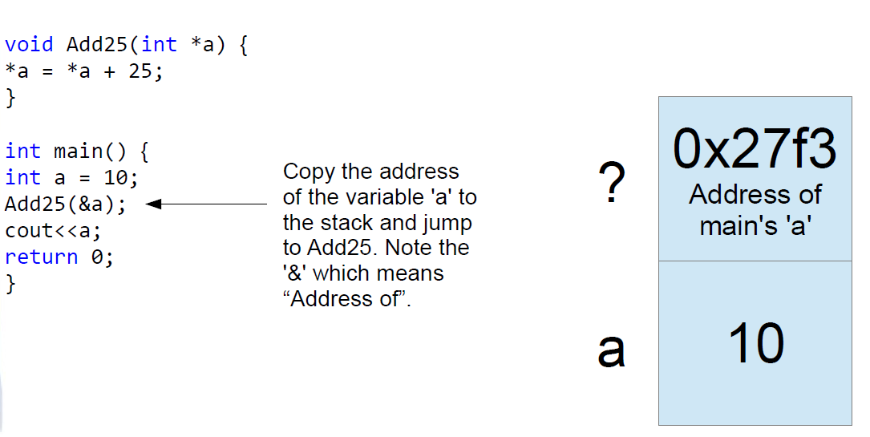
Using Pointers to Allow Add25 to Change main's 'a' variable

Slide 20
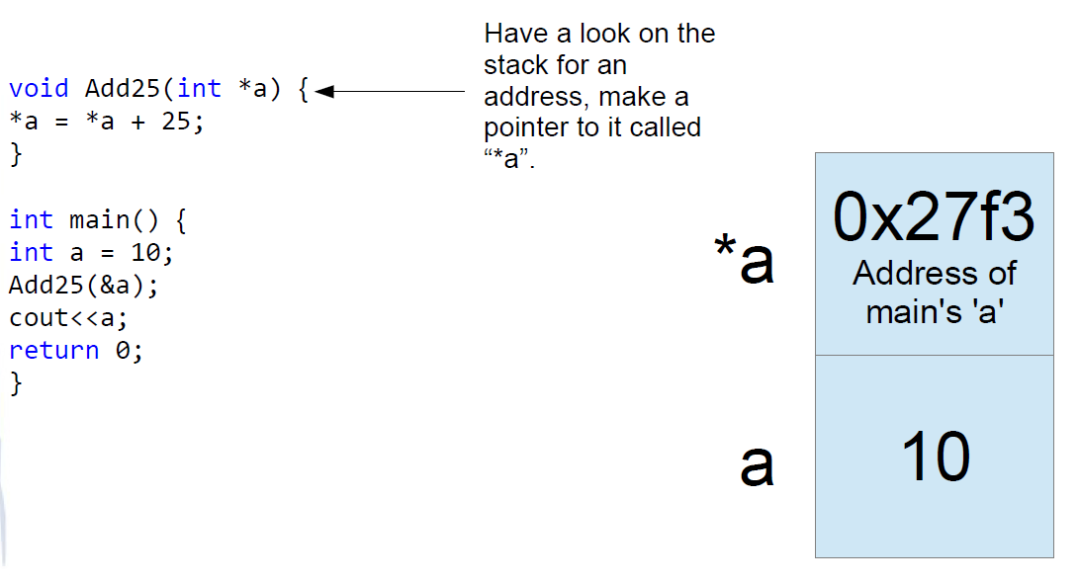
Using Pointers to Allow Add25 to Change main's 'a' variable

Slide 21
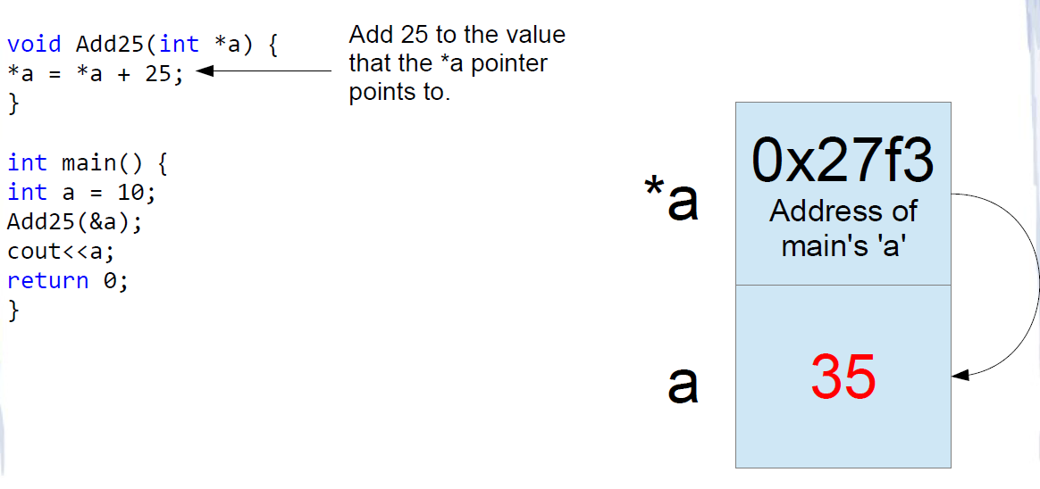
Using Pointers to Allow Add25 to Change main's 'a' variable

Slide 22
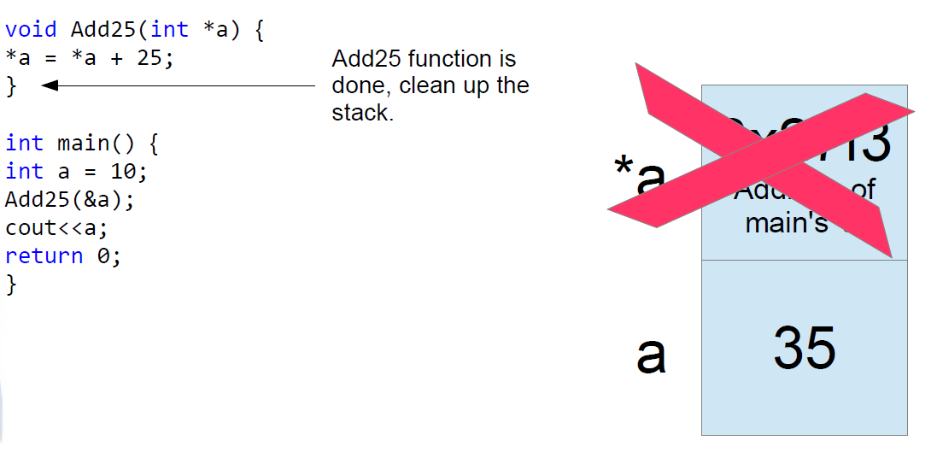
Using Pointers to Allow Add25 to Change main's 'a' variable

Slide 23
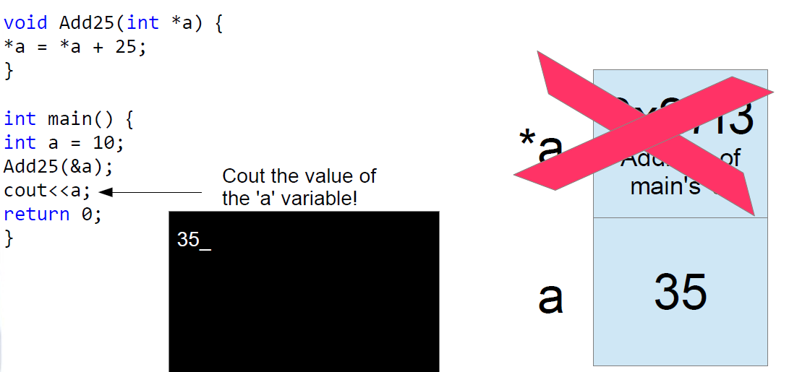
Using Pointers to Allow Add25 to Change main's 'a' variable

Slide 24
Note on Pointers
Note that adding 25 to a pointer is not the same as adding 25 to the value of the pointer. If in the Add25() function we neglected the “*” before the “a” pointers, we'd actually be causing “*a” to point to an address 25 bytes higher in RAM.
This would not have effected the variable 'a' in main(). It would in fact be setting the pointer “*a” to point to some other variable we probably shouldn't be changing!

Slide 25
We passed the address of 'a' instead of the value
And the Add25 function altered main's copy of the variable 'a' by creating a pointer from the address that main() passed as a parameter.
This is such a common thing to do that there's a special syntax that we can use. It's called “pass by reference” as opposed to pass by value (the first example) or pass by pointer (the second example).

Slide 26
Syntax
All you've got to do to pass by reference is place the “&” before variable names in the function's parameters:
int SomeFunction(int &i)
It looks the same as the “address of”, but it is in a different context. It doesn't mean “address of”, it means “pass by reference”. Pass by reference achieves exactly what the “pass by pointer did” in the previous example only we needn't refer to any pointers!

Slide 27
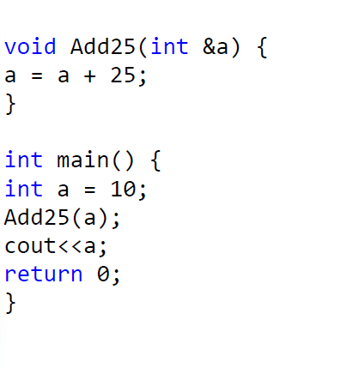
Example

Slide 28
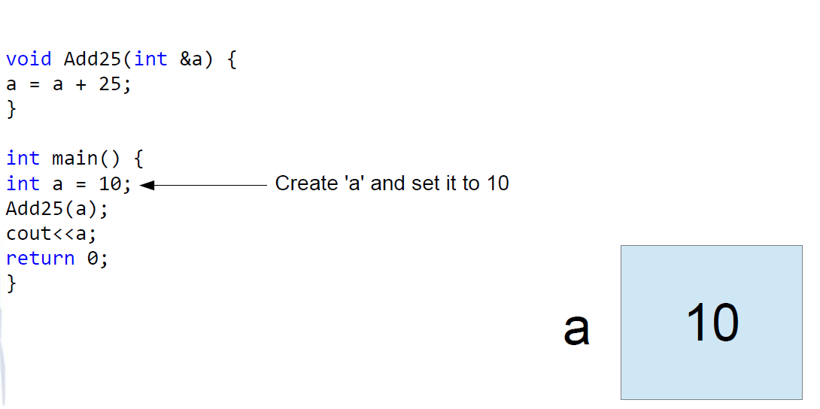
Example

Slide 29
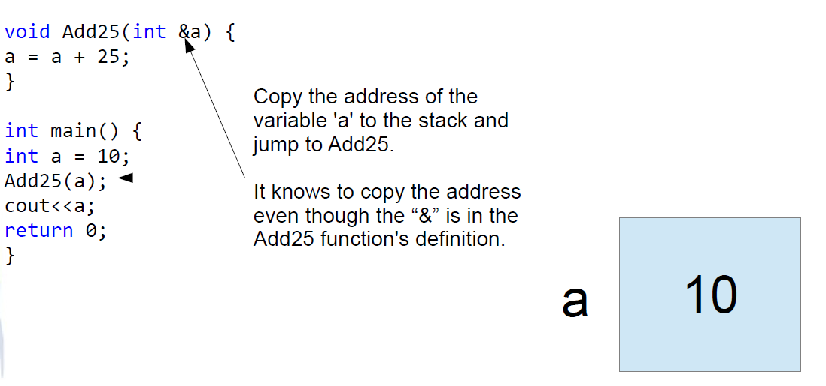
Example

Slide 30
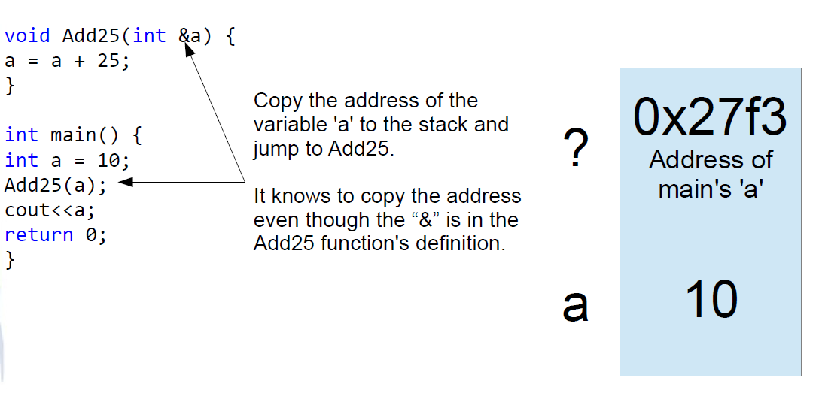
Example

Slide 31
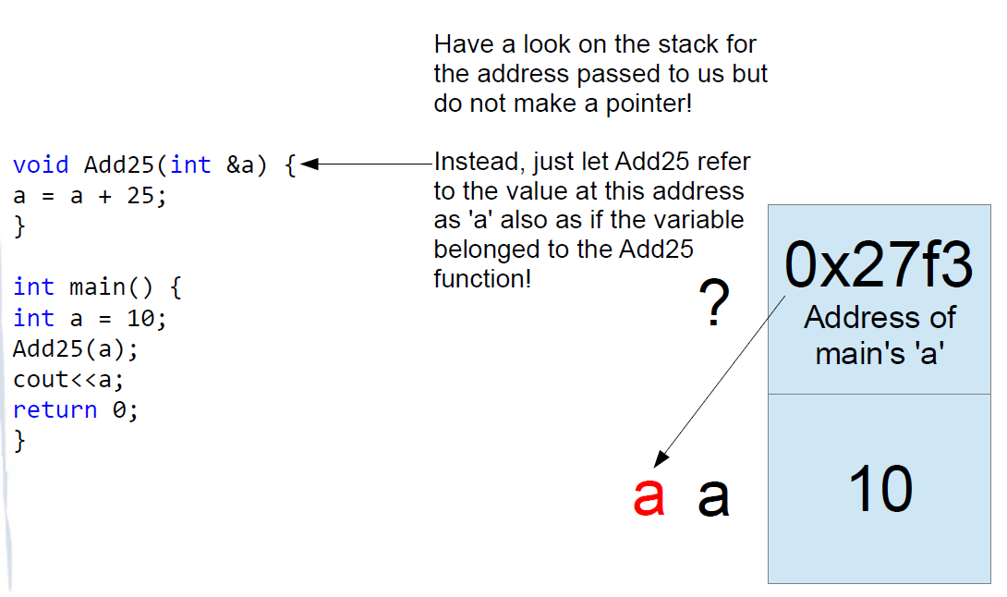
Example

Slide 32
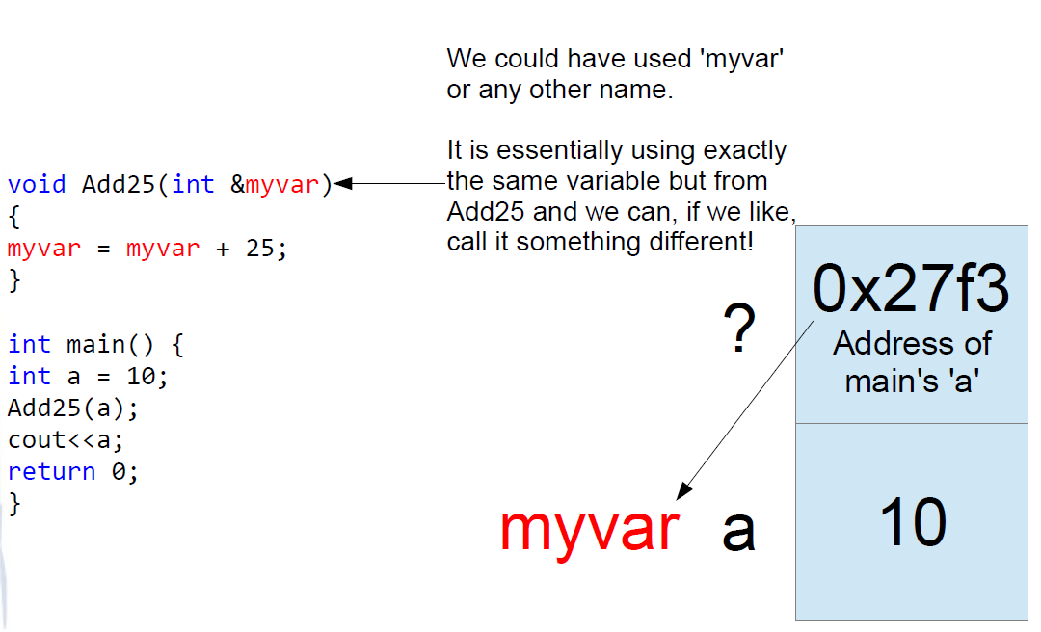
Example

Slide 33
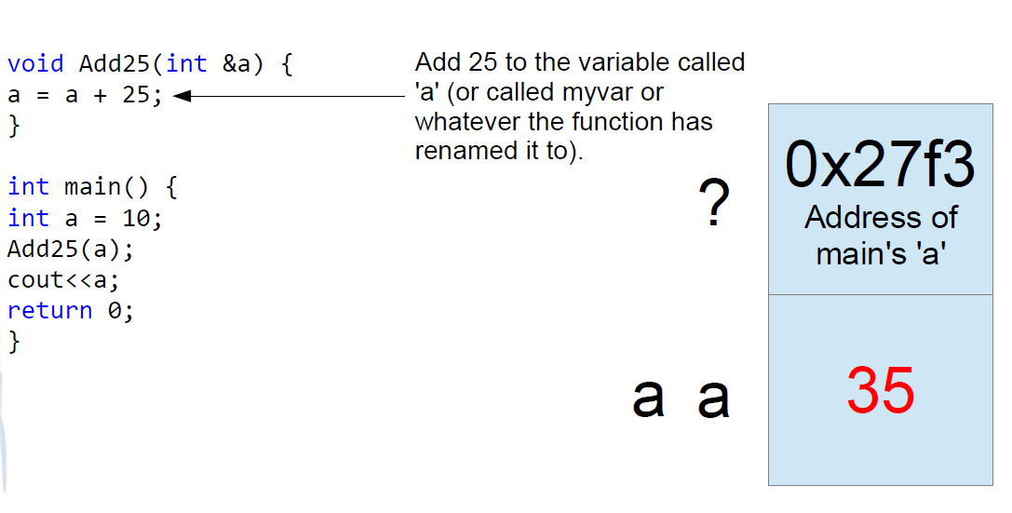
Example

Slide 34
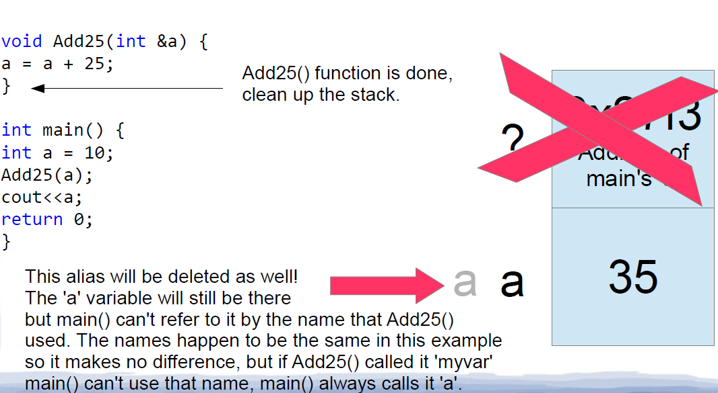
Example

Slide 35
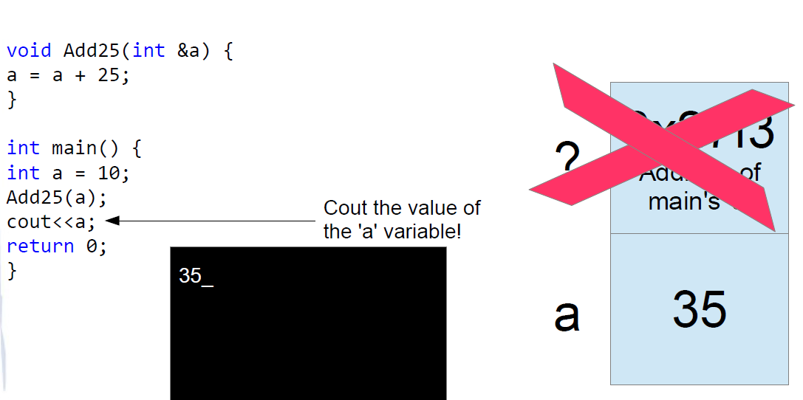
Example

Slide 36
Advantages of Passing by Reference/Pointer
The advantages of passing addresses rather than values are that the sub functions can effectively “return” more than one result:
int SomeFunction(int &a, int &b, int &c)
Also, when we get into defining our own data types we'll see that sometimes they can be very large, it is too slow to copy them to the stack so instead we just pass the address which is a single value!

Slide 37
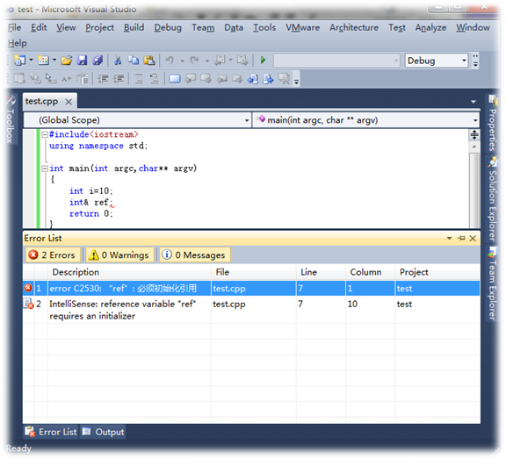
Difference between Reference and Pointer
Pointer could be null, but reference could not
Pointer should be checked null or not before used, but reference is not necessary!!

Slide 38
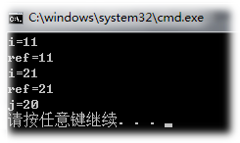
Difference between Reference and Pointer
reference could not change the object, but pointer could
#include<iostream>
using namespace std;
int main(int argc,char** argv)
{
int i=10;
int& ref=i;
ref++;
cout<<"i="<<i<<endl;
cout<<"ref="<<ref<<endl;
int j=20;
ref=j;
ref++;
cout<<"i="<<i<<endl;
cout<<"ref="<<ref<<endl;
cout<<"j="<<j<<endl;
return 0;
}
"指针指向一块内存，它的内容是所指内存的地址；而引用则是某块内存的别名，引用不改变指向。"

Slide 39
Difference between Reference and Pointer
"指针指向一块内存，它的内容是所指内存的地址；而引用则是某块内存的别名，引用不改变指向。"

